Slide 1
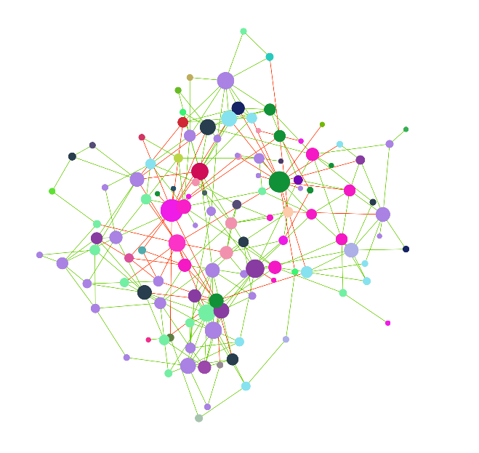

Tutorial: network analysis with manta and anuran
Lisa Röttjers, Karoline Faust
Lab of Microbial Systems Biology
REGA institute, KU Leuven
github.com/ramellose/manta
github.com/ramellose/anuran

Slide 2
Choose your own tutorial
Installation instructions
networktutorials/installation_demo.html
manta vignette
manta/demo_manta.html
Network analysis in Python
networktutorials/python_demo.html
Arctic soils with manta and anuran
networktutorials/workshop_demo.html
anuran vignette
anuran/demo_anuran.html
anuran API
anuran/demo_API.html

Slide 3

Installation instructions
Use a virtual environment to install packages
Use pip to automatically install all dependencies
numpy 1.16
pandas 0.22.3
numpy 1.11
pandas 0.19.5
numpy 1.19
pandas 0.25.1
https://ramellose.github.io/networktutorials/installation_demo.html

Slide 4
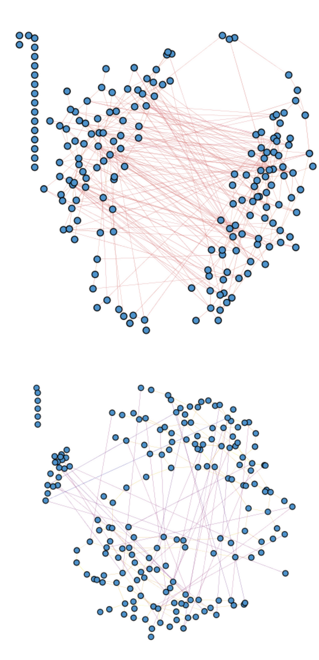
Arctic soils with manta and anuran
Continue with the arctic soils data
Analyze FlashWeave and SPIEC-EASI networks
Generate analysis with manta and anuran
Visualize in Cytoscape
Plot analysis tables with ggplot2
https://ramellose.github.io/networktutorials/workshop_demo.html

Slide 5

manta vignette
More explanations on manta parameters
Analyze associations between afrotropical bats and their diets
https://ramellose.github.io/manta/demo_manta.html

Slide 6

anuran vignette
More explanations on anuran parameters
Find patterns in 3 similar blocks of soil samples
https://ramellose.github.io/man/demo_anuran.html

Slide 7
anuran API
How do you extract null models from anuran?
How could you add your own centrality scores?
https://ramellose.github.io/man/demo_api.html

Slide 8
Network analysis in Python
Use Python with NetworkX
NetworkX contains features not implemented in igraph (R)
Algorithms
Interfaces with standard graph formats
Generators for graph types
Convenient network object structure
Easy to access through loops
BIOM format accessible in Python
https://ramellose.github.io/networktutorials/python_demo.html

Slide 9
Network analysis in Python
Use Python with NetworkX
NetworkX contains features not implemented in igraph (R)
Algorithms
Interfaces with standard graph formats
Generators for graph types
Convenient network object structure
Easy to access through loops
BIOM format accessible in Python
https://ramellose.github.io/networktutorials/python_demo.html

Slide 10
Choose your own tutorial
Installation instructions
networktutorials/installation_demo.html
manta vignette
manta/demo_manta.html
Network analysis in Python
networktutorials/python_demo.html
Arctic soils with manta and anuran
networktutorials/workshop_demo.html
anuran vignette
anuran/demo_anuran.html
anuran API
anuran/demo_API.html
https://ramellose.github.io/ + extension

